Slide 1
Emails
Dr Dhishna P
Associate Professor
School of Management
National Institute of Technology Karnataka

Slide 2
Advantages
Fastest mode of communication
Communication in shortest time
Short mode of communication- less than 200 words
More recepients can receive the message at the same time
Messages can be saved and stored
Emails are printer friendly and retrievable
Quick response to the problem

Slide 3
Advantages
Emails can be marked based on priority: high, medium and low
Emails are editable
Images, videos, and audio files can be attached with emails
Emails can be sent and received from anywhere provided the internet connection is good
Messages can be retrieved and used even after long time

Slide 4
Disadvantages
Once send it cannot be retraced beyond a given duration
Email ids can be hacked and duplicated hence challenge to privacy
Junk emails or spams can be a cause of concern
Phishing emails can be a concern
Use of acronyms can create confusion
Emoticons are not welcome in official correspondences

Slide 5
Acronyms - sample
ASAP- As Soon as Possible
BTW- By the way
FAQ- Frequently asked questions
HTH- Hope this helps
IAE- In any event
IMO- In my opinion
LOL-Laughing out loud
TC- Take care
AAMOF- As a matter of fact
IAC- In any case
NRN- No reply necessary
TIA- Thanks in advance
SITD- still in the dark
TTYL- Talk to you later
BFN- Bye for now

Slide 6
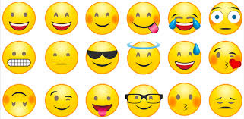
Emoticons/emotional icons- Samples
Happy
Surprise
Sad
Angry
Shocked
Confused
Worried
Sick
Tired

Slide 7
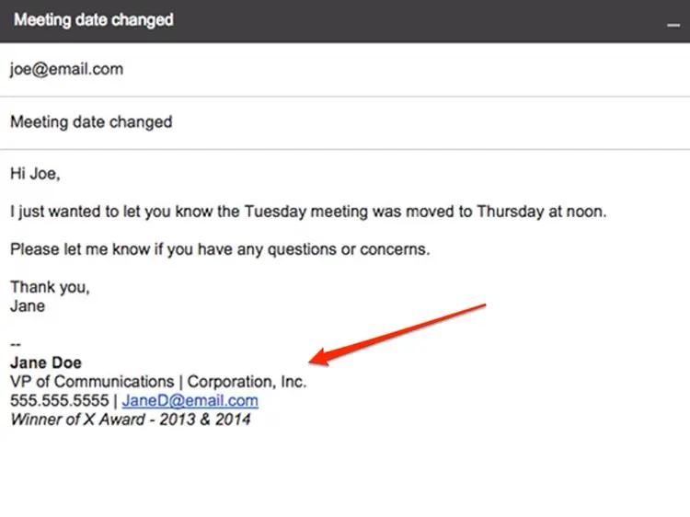
Sample email

Slide 8
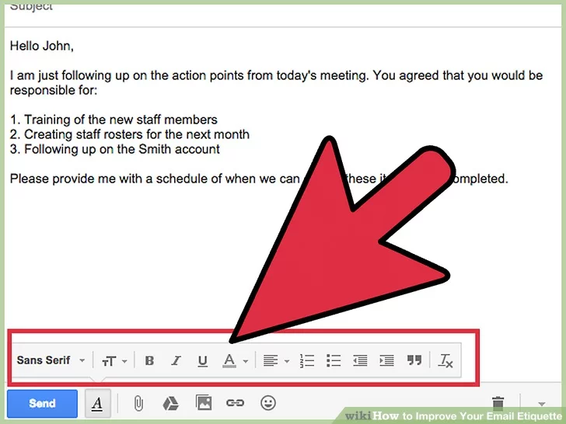
Optional elements

Slide 9
Email etiquette
Quick/immediate response
Use cordial language
Do not overuse reply all option
Proper structure and layout- short paragraphs with sufficient gaps
Use signature line to effectively identify the sender
Make the content clear in subject line
Answer all queries
Be concise and to the point

Slide 10
Email etiquette
Use proper spelling, punctuation and grammar
Do not write in capitals
Avoid long sentences-15-20 words only
Use active voice than passive voice
Eg: We will process your order today
Your order will be processed today
Language used should be gender neutral
Include the original mail in reply so that coherence is maintained

Slide 11
Email etiquette
Do not use “high priority” option often
Do not attach unnecessary files
Re-read the mail before you send it
Minimal use of abbreviations and emoticons
Do not use emails to discuss confidential matters
Wisely use bcc and cc options
Do not reply to spam

Slide 12
Thank you…

